Slide 1
myMITC Overview & Training
Aquatico Pool Management, inc.

Slide 2
myMITC Website
Go to www.aquatico-pools.com
Under Employment -> myMITC
Type in
https://timeclock.aquatico-pools.com/MyMITC/2/
Best & Quickest Way!
BOOKMARK THE WEBSITE OR
CREATE A SHORTCUT APP (shown on next slide)

Slide 3
Create a clock in/out shortcut on your phone
apple
android
Log onto myMITC from your browser
Click the menu icon in the top left
Select clock in/out
Click the share button
Middle box with up arrow
Add to home screen
Log onto myMITC from your browser
Click the menu icon in the top left
Select clock in/out
Click the overflow button
Three vertical dots
Add to home screen
Menu

Slide 4
myMITC HOME SCREEN
OVERFLOW MENU
USER MENU

Slide 5
USER MENU
ALL EMPLOYEES BEGIN WITH THE SAME PASSWORD… LOG IN AND CHANGE IT!
Open Shifts:
Request More Shifts
Select for best viewing on cell phones
myMITC U:
Mini Tutorials if you have questions about the system
LOG OUT:
MAKE SURE YOU LOG OUT EACH DAY TO ALLOW FOR SYSTEM UPDATES
Job Calendars:
Use myCalendar under Menu Overflow to see your scheduled shifts

Slide 6
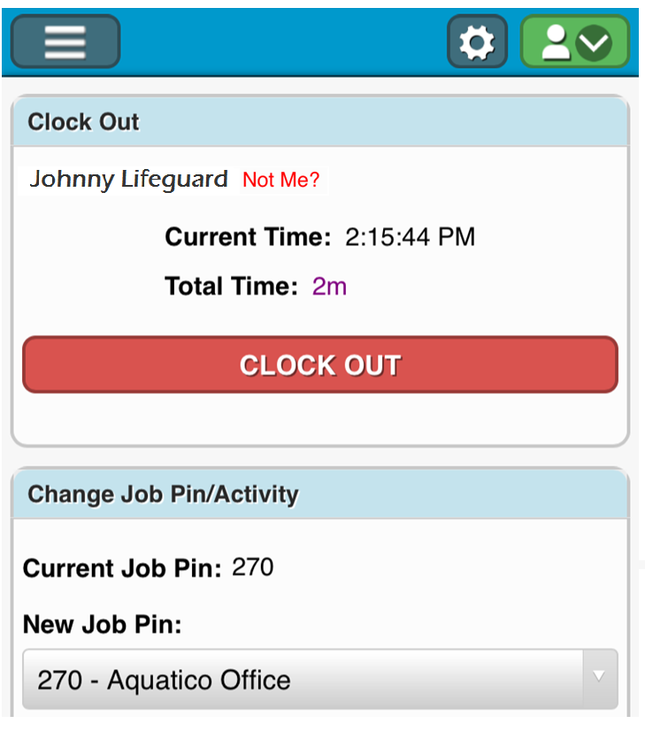
Clock in/out
Log onto myMITC
Click CLOCK IN/OUT
Job Pin will auto populate (Geofencing)
Must be at the facility to clock in/out
**MOST IMPORTANT FEATURE**
THIS IS HOW YOU WILL RECEIVE A PAYCHECK!

Slide 7
Geo “FENCING”
Geofence: a virtual geographic boundary, defined by GPS, that enables software to trigger a response when a mobile device enters or leaves a particular area.
Employees MUST BE PHYSICALLY at their facility to CLOCK IN/OUT
Employees should arrive at least 10 minutes before pool opens to be on the lifeguard stand by scheduled start time.
Employees may not clock out or leave until the end of their shift
Location MUST be turned on in Location Services, and myMITC allowed access

Slide 8
location services
apple
android
Settings
Privacy
Location Services
Share My Location
safari
Select while using
Settings
location
Swipe “On”
Or
swipe down & click icon

Slide 9
myTIMESHEET
Click on the time to review error
KEY

Slide 10
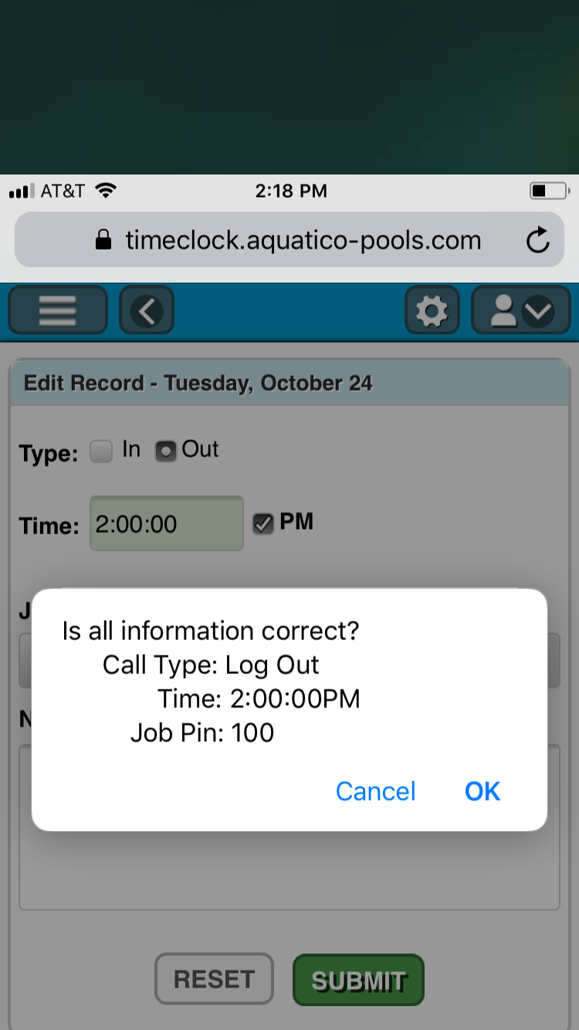
myTIMESHEET
Click on ‘Add attendance record’
Complete the attendance record
Verify the information
Select type: in/ out
enter time (for afternoon click pm)
Select Job pin
Select activity code
Include a reason
*All Attendance Requests Must Be Approved By Your Supervisor

Slide 11
ATTENDANCE REQUEST
3 Strike Attendance Rule
Failure to Clock In / Out
Late Clock Ins / Early Clock Out
Failure To Submit Request In Timely Manner
Clocking In Outside Designated Shift Times
Failure To Report Covered / Traded Shift to Mgmt.
Failure To Show For Scheduled Shift
YOU ARE RESONSIBLE FOR CLOCKING IN/OUT
IF YOU FORGET, YOU MUST APPEND YOUR TIMESHEET FOR YOUR SUPERVISOR TO APPROVE. IT MUST INCLUDE A REASON.
FAILURE TO CLOCK IN/OUT OR APPEND YOUR TIMESHEET, MAY RESULT IN DELAY OF A CORRECT PAYCHECK.
Zero Tolerance – Automatic Termination
No Call - No Show
Clocking In Not On Site
Clocking In Colleges
GPS Spoofing
Falsifying Attendance Record
3 STRIKE RULE:
3 STRIKES IN ONE PAY PERIOD (2 WEEKS) WILL LEAD TO AN AUTOMATIC WRITE UP
WRITE UPS CAN LEAD TO TERMINATION, LOSS OF BONUSES, AND REMOVAL FROM SCHEDULE.

Slide 12
myCALENDAR
WANT MORE SHIFT? CLICK HERE
POOL MANAGERS AND/OR SUPERVISORS ARE RESPONSIBLE FOR ENTERING SCHEDULES INTO myMITC.
YOU ARE RESPONSIBLE FOR LETTING YOUR POOL MANAGER AND/OR SUPERVISOR KNOW YOUR SCHEDULE AT LEAST 3 WEEKS OUT.
CLICK ON THE NAME OF THE FACILITY FOR THE ADDRESS.
IF YOU ARE UNABLE TO WORK YOUR SHIFT, YOU MUST FIND COVERAGE AND LET YOUR POOL MANAGER AND/OR SUPERVISOR KNOW OF THE CHANGE.

Slide 13
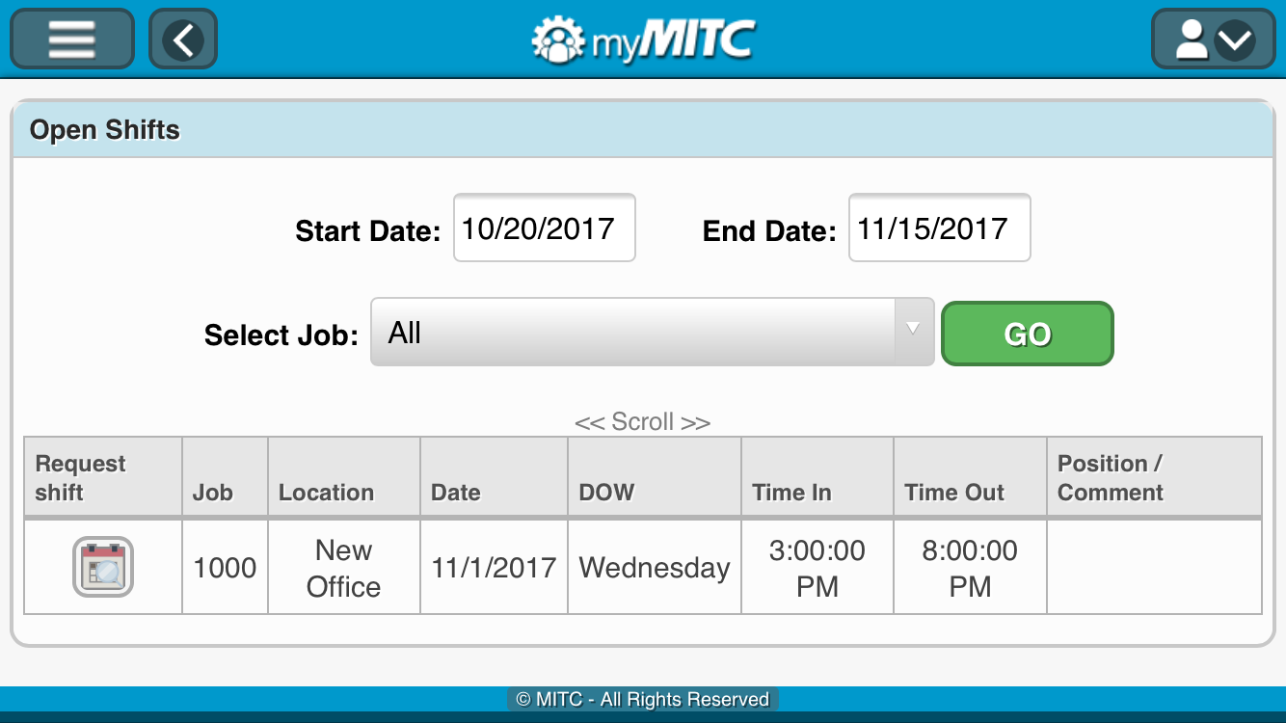
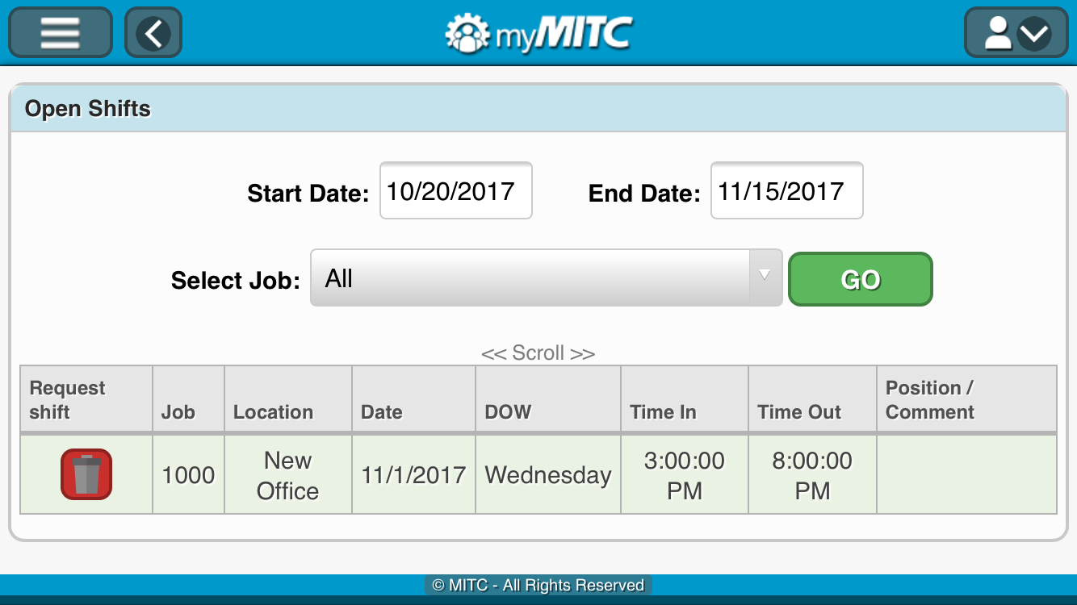
myCALENDAR: OPEN SHIFTS
IF YOU WOULD LIKE ADDITIONAL SHIFTS, YOU CAN REQUEST THEM.
ENTER DATE RANGE
SELECT JOB (FACILITY)
CLICK ON TO REQUEST SHIFT
REQUEST ENTERED IF GARBAGE CAN ICON APPEARS.
TO CANCEL REQUEST, CLICK ON ICON
PENDING REQUEST
APPROVED REQUEST
REQUESTED SHIFTS ARE NOT YOURS UNTIL YOUR POOL MANAGER AND/OR SUPERVISOR APPROVES THEM.

Slide 14
Create a shortcut of the website to your home screen
Change your password after first log in
Don’t forget your password and username (if you do, fill out a myMITC Help Form on our website)
Approve access to your Location – GeoFence
Clock in/out for all your scheduled shifts- Your responsibility!
Check your timesheet for any discrepancies
Remember to check your schedules
Log out of myMITC every day
Bring a charger or brick to work because if your phone dies you won’t be able to clock in/out
Phones are not permitted on stand and are only to be used to clock in/out

